Slide 1


Credit Card Transaction & Customer Report: Data Insights & Analysis
This presentation will analyze key credit card metrics. The report includes revenue, transactions, and customer insights. The goal is to provide a clear overview. It will help inform strategic decisions.
by Sangram Sonawane

Slide 2
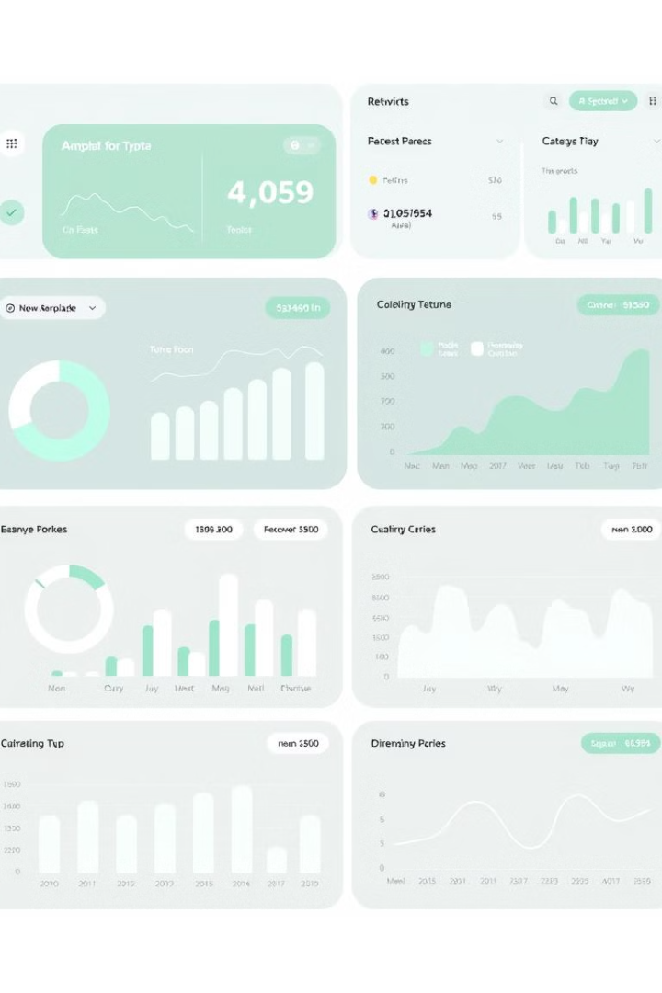
Key Metrics Overview
$57M
Revenue
Total revenue generated from credit card transactions.
$46M
Transaction Amount
The total value of all transactions made.
$8M
Interest Earned
The total interest earned from cardholders.
667K
Transaction Count
Number of credit card transactions processed.

Slide 3
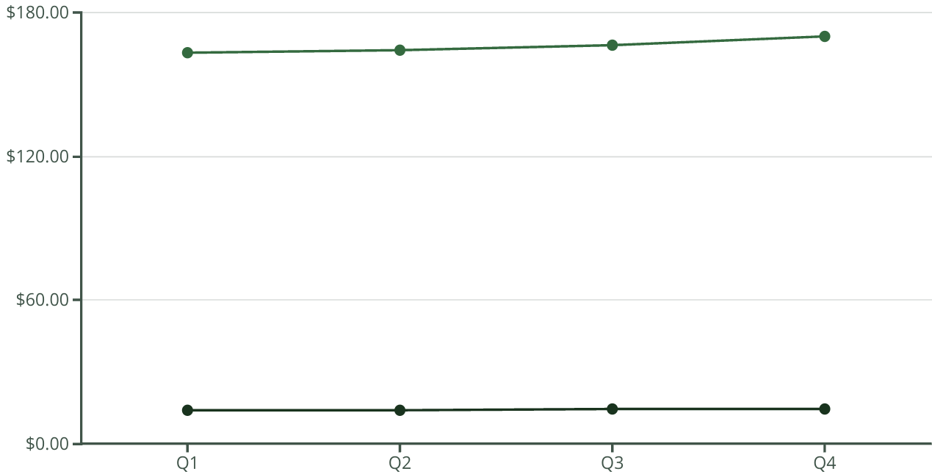
Quarterly Revenue & Transactions
Revenue (Millions)
Transactions (Thousands)
Revenue and transactions increased steadily, peaking in Q4. This growth suggests strong card usage. Focused marketing efforts could be the cause. Another cause could be seasonal spending.

Slide 4
Credit Card Performance
Blue Card
Silver Card
Gold & Platinum
Highest revenue ($47M). It also has the most transactions. Blue card holders are frequent users.
Generated $6M in revenue. This card caters to a specific customer segment. The benefits and usage patterns differ.
These cards had a lower revenue contribution. These cards are used by premium customers. They may have different spending habits.

Slide 5



Payment Method Analysis
Chip
2
Chip transactions generated $17M in revenue. They show increased security awareness.
Swipe
1
Swipe transactions led with $36M revenue. This reflects traditional payment preferences.
Online
Online transactions were lower at $4M revenue. This indicates room for growth. Boost online payment adoption.
3

Slide 6

Customer Demographics & Spending
Graduates
Businessmen
Bills
Graduates contributed the most with $23M. This demographic is a key revenue driver. Offer tailored financial products.
Businessmen generated the highest revenue at $18M. This group represents high-value customers. Offer premium services to businessmen.
Top spending category was bills at $14M. This suggests reliability in payment behavior.

Slide 7
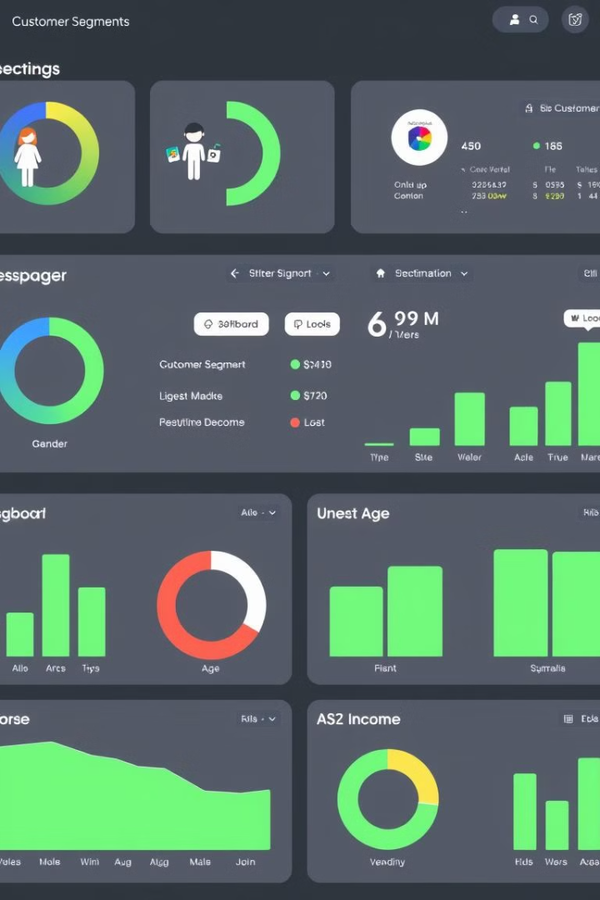




Customer Segmentation Analysis
Gender
Males ($31M) contribute higher revenue than females ($26M). There may be potential for targeting women.
Age
Age group 40-50: Highest revenue ($24M), followed by 50+ ($20M). Target offers to these demographics.
Income
High-Income Group: $23M revenue. This segment values premium services and higher limits.
Marital Status
Married Customers: Higher revenue ($16M) than singles ($13M). Tailor financial planning products.

Slide 8

Top Performing States
California (CA)
1
Highest revenue, ~$7M. A key market for expansion.
2
New York (NY)
High revenue, similar to CA at ~$7M. A core market for credit card usage.
Texas (TX)
3
Moderate revenue contributor. Offers growth opportunities.
4
Florida (FL)
Moderate revenue contributor. Focus on targeted campaigns.

Slide 9

Dependent Count & Revenue
1
1-2 Dependents
Customers with 1-2 dependents contribute the highest revenue. Target financial products to families.
Customer with dependents contribute the most revenue. Financial products need to be tailored to these customers.

